Slide 1

Randomization
COMP 2210 – Dr. Hendrix

Slide 2
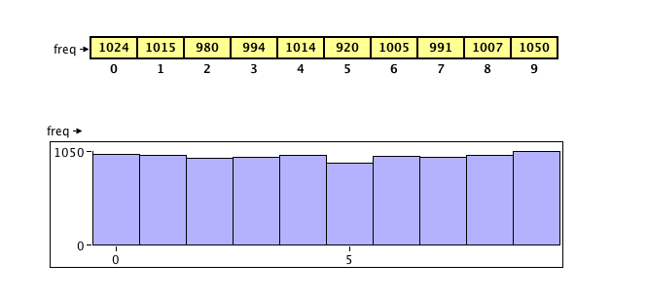
Selecting uniformly at random …
RandomizedList<Integer> list = new RandomizedList<>();
int[] freq = {0,0,0,0,0,0,0,0,0,0};
// add 0..9, then add/remove 10,000 times counting freq of each element
for (int i = 0; i < 10; i++)
list.add(i);
for (int i = 0; i < 10000; i++) {
Integer element = list.remove();
freq[element]++;
list.add(element);
}

Slide 3
java.util.Random
http://docs.oracle.com/javase/7/docs/api/java/util/Random.html
public class Random extends Object implements Serializable
An instance of this class is used to generate a stream of pseudorandom numbers. The class uses a 48-bit seed, which is modified using a linear congruential formula. (See Donald Knuth, The Art of Computer Programming, Volume 2, Section 3.2.1.)
public int nextInt(int n)
Returns a pseudorandom, uniformly distributed int value between 0 (inclusive) and the specified value (exclusive), drawn from this random number generator's sequence. The general contract of nextInt is that one int value in the specified range is pseudorandomly generated and returned. All n possible int values are produced with (approximately) equal probability.

